Slide 1
Picture Database
CIS 386 Database Management Systems
Brendan Short
12/3/25

Slide 2
Organization Info and Requirements
Client: my dad, hobby landscape & drone photographer in Northern Michigan.
Current state: everything on a single external drive, loose folders, no real catalog/search.
Risks & pain points: hard to find “that one photo,” single point of failure with everything stored on one drive.
Requirements: searchable library, tagging, collections, video showcase.

Slide 3
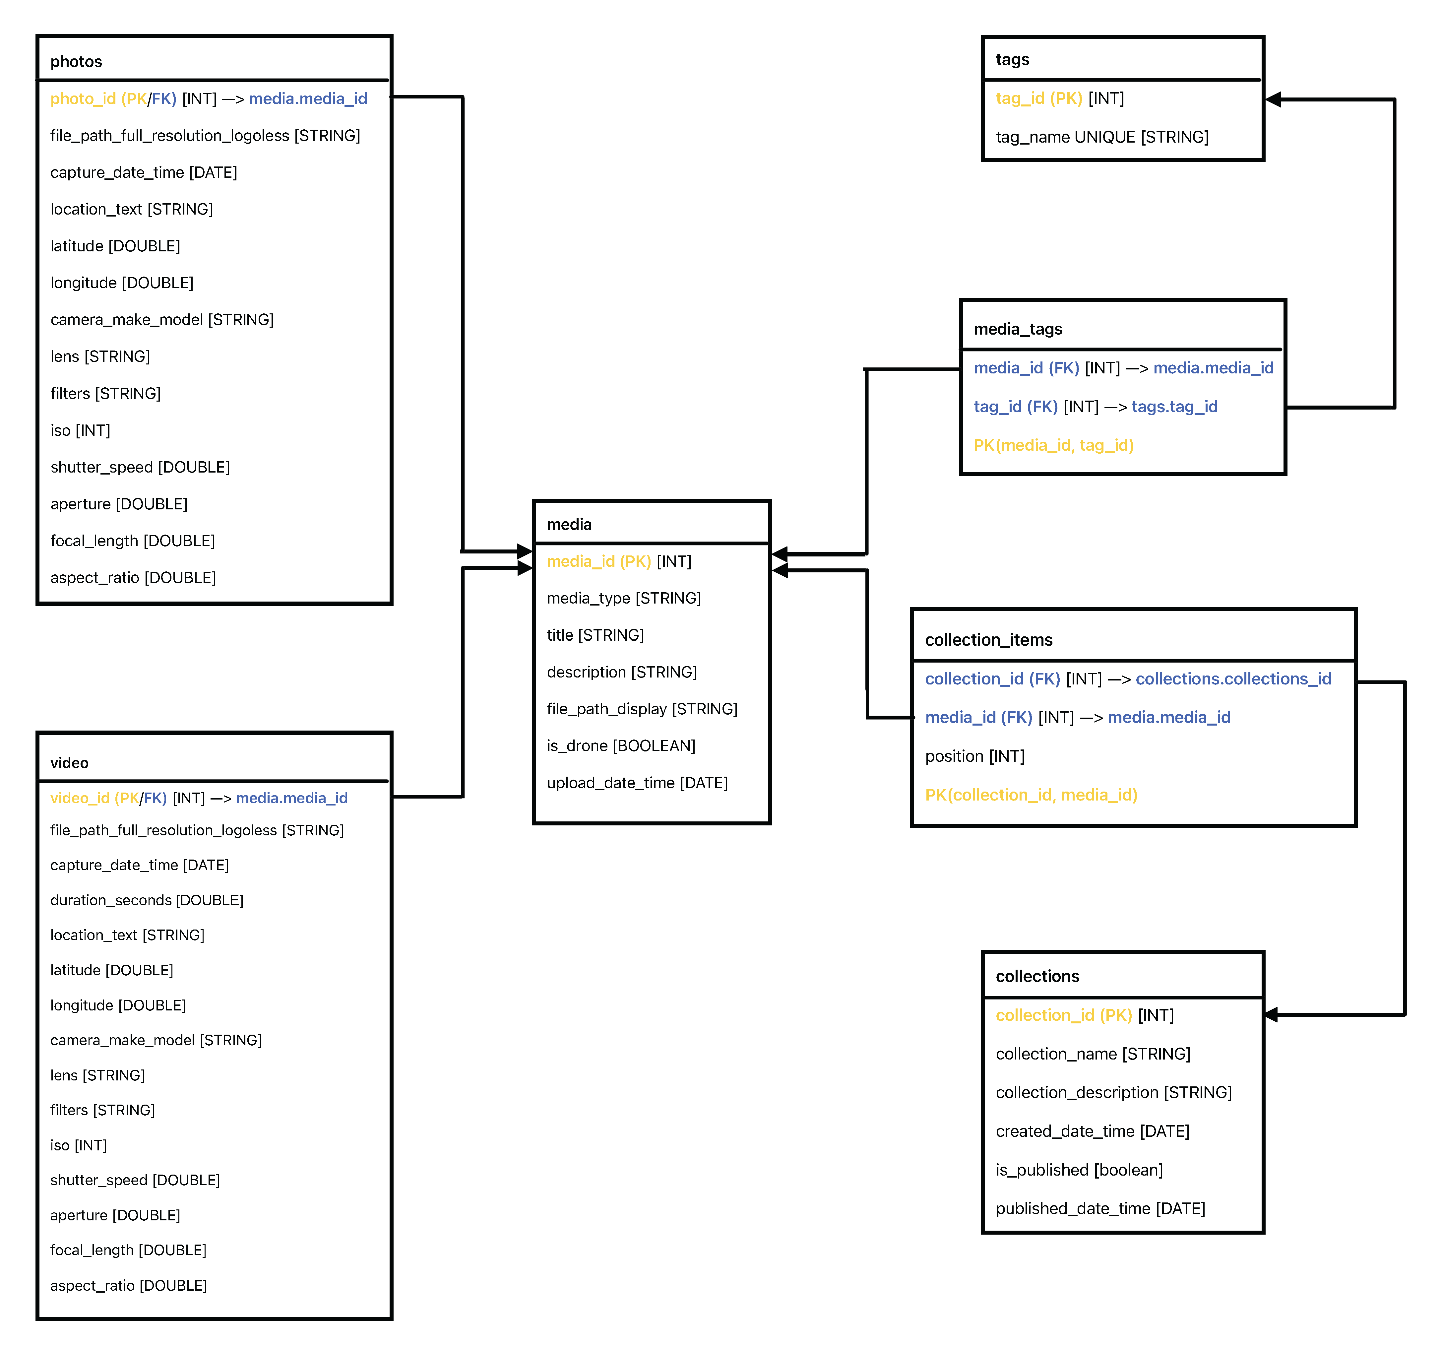
Schema
Central media table: one row per photo or video (title, description, display file path, drone flag, upload datetime).
Subtype tables photos and videos share the same PK as media for photo/video-specific EXIF fields.
Tagging via tags + media_tags (zero-to-many).
Curated collections of media via collections + collection_items (zero-to-many with position attribute so collections can be ordered whichever way they want).

Slide 4
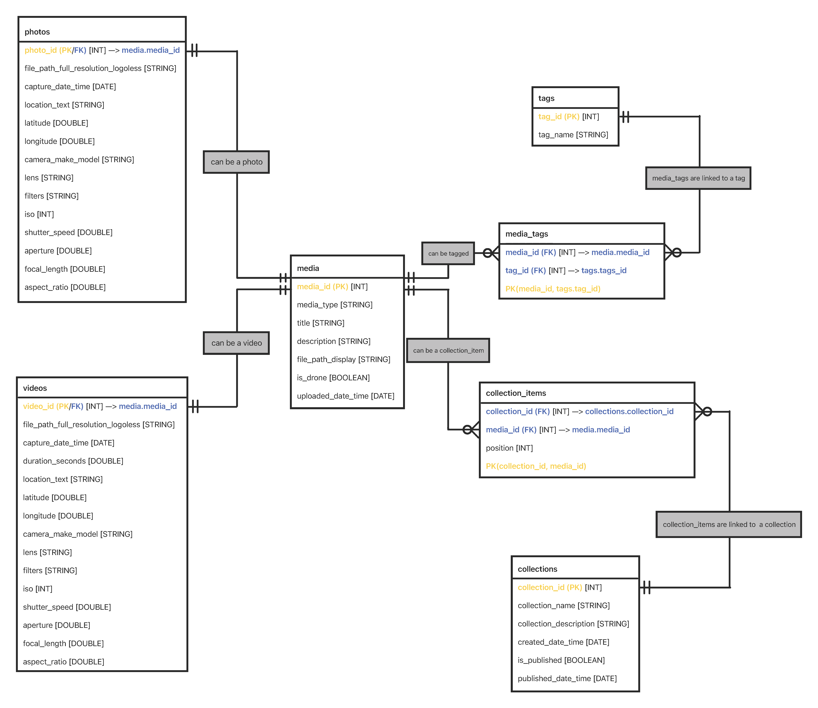
ER Diagram
media at the center
1–1 from media → photos and media → videos
  Media can be considered a supertype with photos and videos begin a subtype
0–M between media and tags via media_tags (association table)
0–M between media and collections via collection_items (association table).

Slide 5
MySQL Data Analytics: 5 Questions
How many media items do we have by type (PHOTO vs VIDEO) and by drone vs non-drone?
What are the top 10 most-used tags across all media?
For each collection, how many total items, drone items, photos, and videos does it contain?
For 2025, how many photos were captured per month?
For each tag, what percentage of tagged media are drone media?

Slide 6
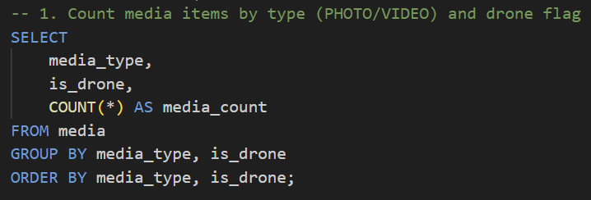
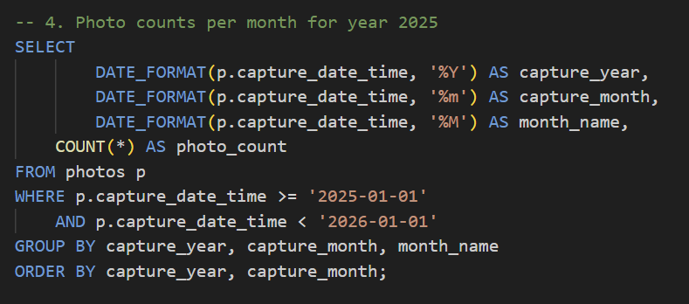
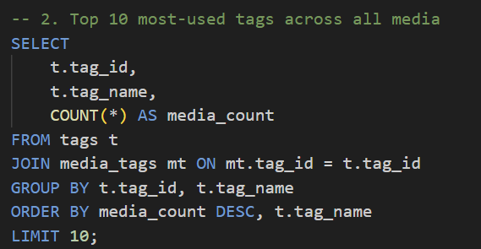
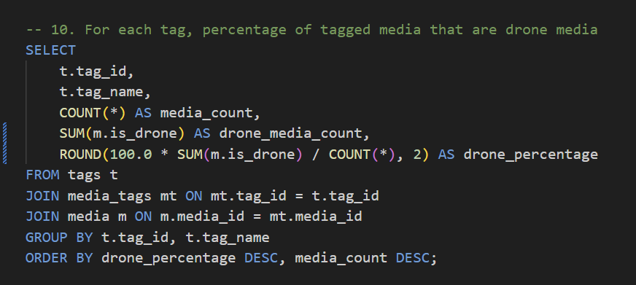
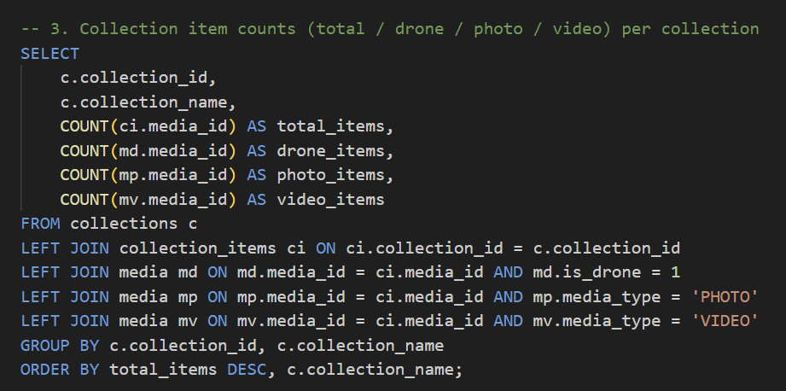

Slide 7
Problems With MySQL
A lot of effort: multi-step manual ingestion (Lightroom export → ExifTool → CSV cleanup → SQL INSERT scripts.
Rigid schema: adding new EXIF fields means schema changes and new ingestion queries.
Not scalable: current pipeline doesn’t scale to hundreds or thousands of new files per month.

Slide 8
Solution With MongoDB
One document per media item, instead of spreading data across 5+ tables.
Embed EXIF/capture metadata, tags, and collection membership inside each document.
Handle missing or extra fields naturally (schema flexibility).
Use aggregation pipelines to answer the same analysis questions as MySQL.

Slide 9
MongoDB Schema
Single media collection; each document in this collection is a photo or video.
Embedded fields and subdocuments to construct the media object:
  capture: dateTime, durationSeconds
  camera: makeModel, iso, shutterSpeed, aperture, focalLength, etc.
  tags: array of { tagId, name }
  collections: array of { collectionId, name }
Everything fits into one collection, which simplifies reads for a single media item.
Tradeoff: aggregation queries are more complex (lots of $unwind, conditional logic) compared to SQL joins.

Slide 10
Data Analytics With MongoDB: 5 Questions
Count media items by type and drone flag using $group on mediaType and isDrone.
Find the top 10 tags by counting how often each tag appears in tags (using $unwind).
For each collection, compute total items and counts of drone, photo, and video items.
For 2025 photos, group by capture month and count items.
For each tag, compute what percentage of tagged media are drone media.

Slide 11
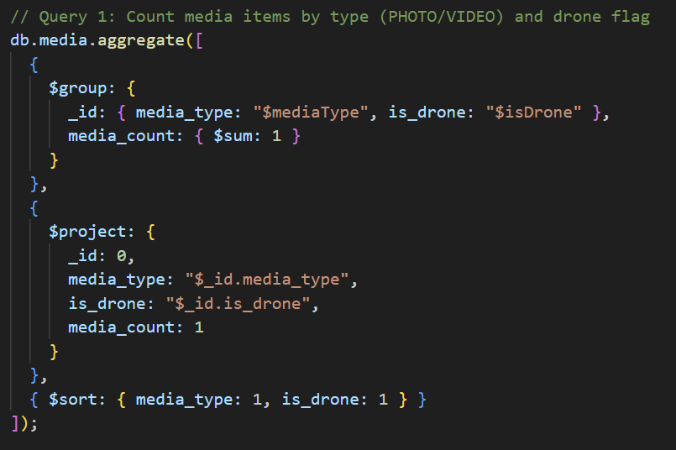
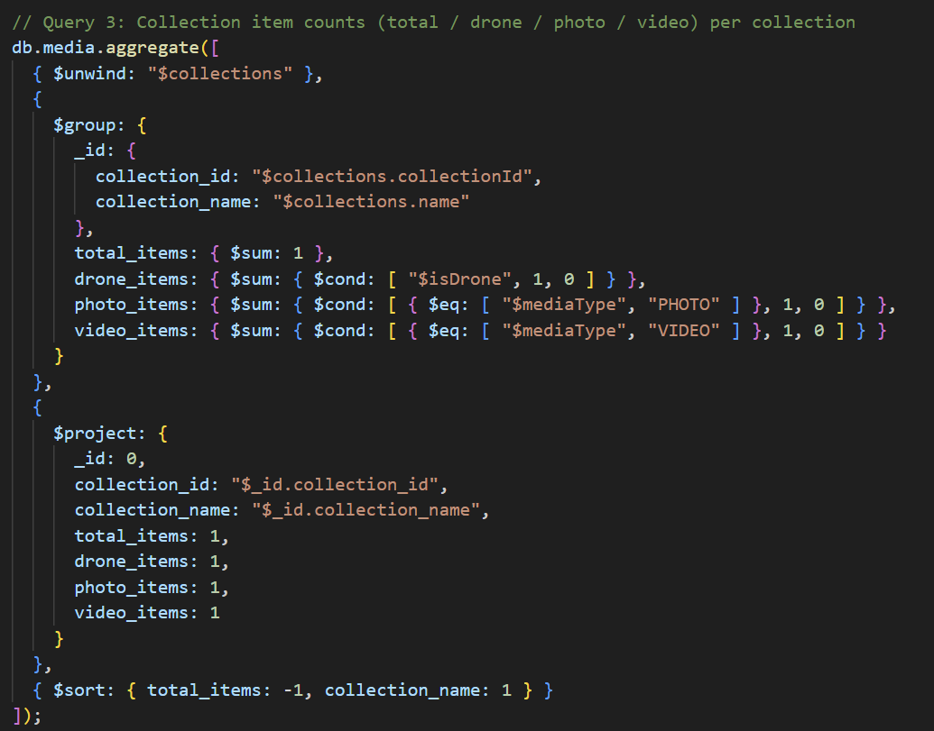
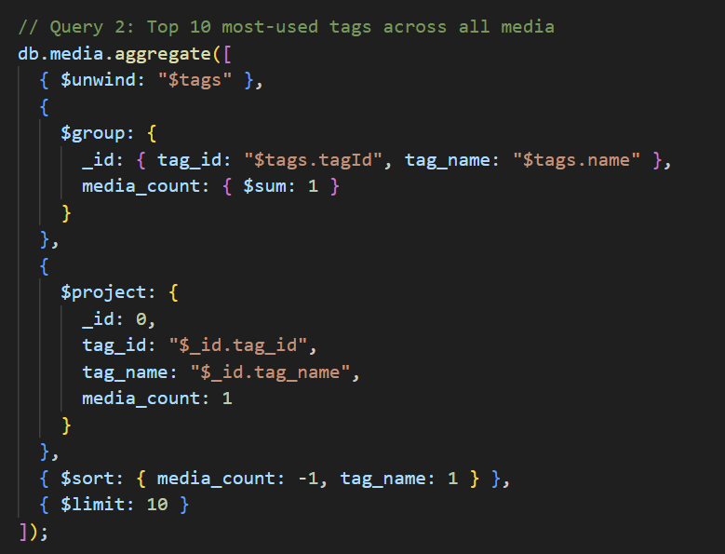

Slide 12
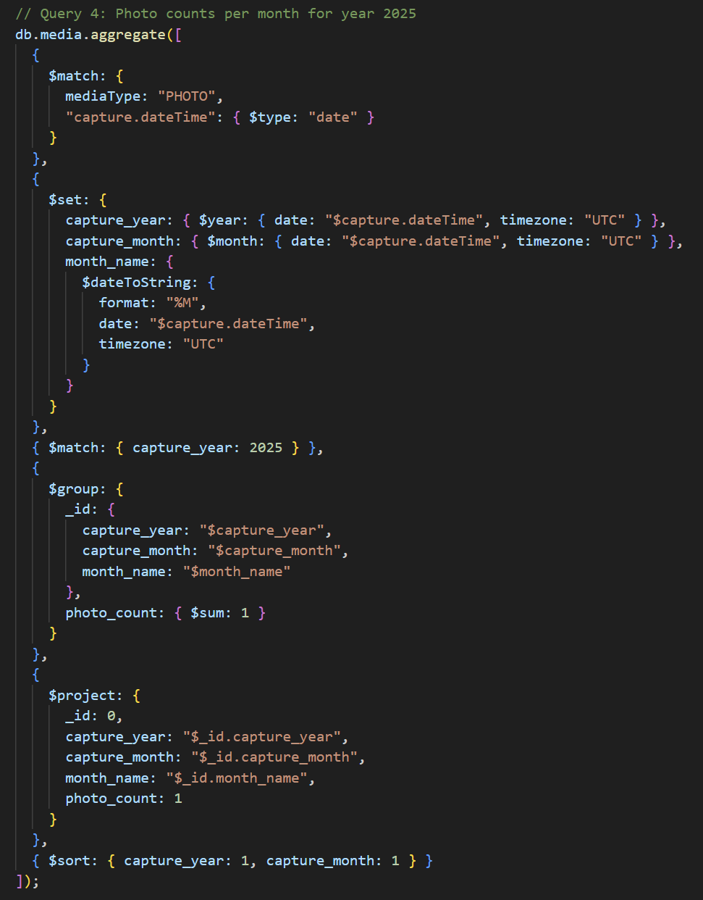
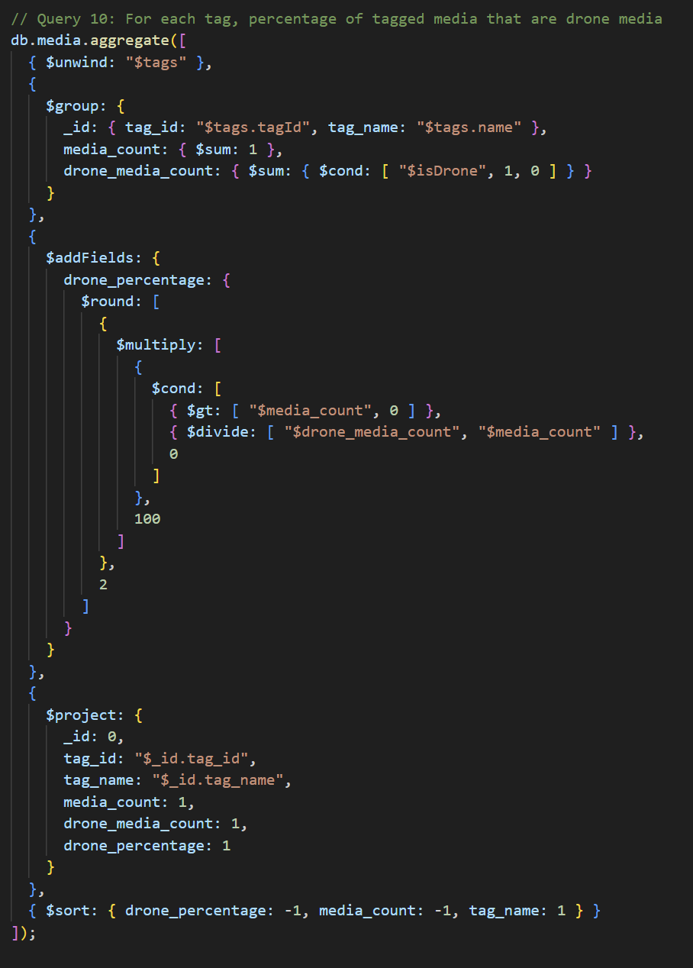

Slide 13
Compare & Contrast: MySQLvs MongoDB
Data model:
  MySQL: tables, strict schema, joins through FKs.
  MongoDB: single media collection with embedded documents, metadata and arrays.
Ingestion & metadata
  MySQL: import pipeline is fragile and high-effort when EXIF changes.
  MongoDB: easier to accept partial or new fields without changing schema.
Analytics
  MySQL: concise SQL for relational questions (GROUP BY, JOIN).
  MongoDB: powerful but more complex aggregation pipelines.
Scalability for this use case
  MySQL: fine for core gallery and reporting, but needs automation around ingestion.
  MongoDB: better fit for changing media metadata, especially if I automate imports.

Slide 14
What I Learned and Challenges
Metadata challenges:
  EXIF fields missing or inconsistent across tools (Windows vs Lightroom vs exports).
  Deciding which fields deserve real columns vs staying optional.
Displaying media in the application layer:
  Keeping full-resolution, display-size, and watermarked paths straight.
  Fixing file-path mismatches that caused broken images and wrong versions to show.
Overall lessons:
  Design from real data and workflows, not just an abstract schema.
    Easy to make sample data. More difficult to manipulate and work with real data.
  Ingestion and metadata quality are just as important as table design. They need to be exact and consistent.
  Modeling the same database in both MySQL and MongoDB gives a deeper understanding of trade-offs.
    MongoDB in my opinion is more difficult to start with, but once configured properly, it is much easier to use.

Slide 15

GitHub Repository
Scan QR to open GitHub repository in browser.
HTTPS clone:
  https://github.com/bcshort1/Database-Project.git
GitHub Desktop Command-Line Interface clone:
  gh repo clone bcshort1/Database-Project

